Slide 1
UNIVERSITY OF FLORIDA · FINAL PROJECT PRESENTATION
Faithfulness-Based Evaluation for Detecting Hallucinations in Text-to-Image Generation
Praneeth Vempati | pvempati@ufl.edu
Final Presentation · University of Florida · 2026
Self-Consistency as an Uncertainty Signal · VQA Faithfulness Scoring · POPE & OK-VQA Benchmarking
Final Project · Hallucination Evaluation in Generative Vision Models
Notes:
Hi, I'm Praneeth Vempati and this is my final project presentation.
My project addresses a fundamental problem in generative AI: when a text-to-image model creates an image, how do we know whether it actually matched what the prompt asked for? The failure mode — where the image looks realistic but gets the semantics wrong — is what I call a visual hallucination. My work builds a complete automated system to detect these failures, validate that the detection metric is meaningful, and use self-consistency across multiple generations as an uncertainty signal. Over the next 10 minutes I'll walk through the problem, the full system, the results, what I learned, and the impact of this work.

Slide 2
PROBLEM & GOALS
The Problem & Project Goals
The Problem
Project Goals
▸ Text-to-image models generate photo-realistic images
Goal 1
▸ But they frequently violate prompt semantics
Build a training-free faithfulness evaluator
▸ Wrong colors, missing objects, broken spatial relations
Goal 2
▸ These semantic failures are called visual hallucinations
Validate metric against ground-truth labels
▸ Human evaluation does not scale — automation is needed
Goal 3
▸ No standardized, free, local evaluation pipeline existed
Use score variance as uncertainty signal
Goal 4
Run on POPE & OK-VQA labelled benchmarks
Notes:
The core problem is visual hallucination in text-to-image generation.
You give a diffusion model a prompt like 'a red cat on a blue chair' and you might get a brown cat on a green sofa. The image is photorealistic, but it fundamentally misrepresents the prompt. Catching this at scale requires automation — human evaluation is too slow and too expensive to apply broadly.
My four project goals were: build a training-free evaluation pipeline using VQA-based faithfulness checks, validate that the metric is meaningful by testing it against ground-truth hallucination labels from the POPE and OK-VQA benchmarks, use score variance across multiple image generations as an uncertainty signal, and build an interactive interface that makes all of this accessible and demonstrable.

Slide 3
FINAL SYSTEM
Complete System Architecture
Text Prompt
Image Generation
Smart Parser
BLIP-VQA Checks
Faithfulness Score
Risk Label
→
→
→
→
→
SELF-CONSISTENCY BRANCH (N images per prompt)
Same Prompt
→
Generate N=3–5
→
Per-image Score
→
Variance Analysis
→
Uncertainty Signal
Generation
VQA
Semantic
Captioning
SD v1.5 / SDXL-Turbo
BLIP-VQA
CLIP ViT-B/32
BLIP Captioner
512×512 · up to 4 steps (Turbo)
Yes/No · Color · Count · Spatial
Cosine prompt–image similarity
Optional secondary signal
Stack: PyTorch · Diffusers · Transformers · Gradio · HuggingFace · scikit-learn · scipy
Notes:
Let me walk through the complete final system architecture.
There are two parallel branches.
The main branch takes a text prompt, generates an image using Stable Diffusion v1.5 or SDXL-Turbo, runs it through a smart prompt parser that extracts objects, colors, counts, spatial relations, and action verbs, passes those structured claims to BLIP-VQA for verification, computes a faithfulness score as the fraction of checks passed, and assigns a risk label.
The self-consistency branch generates N images from the same prompt, computes a faithfulness score for each, and measures the variance. Low variance with high mean means confident and faithful. High variance means uncertain. Low variance with low mean means systematic hallucination.
The four key models are Stable Diffusion for generation, BLIP-VQA for answering faithfulness checks, CLIP for semantic similarity, and BLIP captioner as an optional third signal.

Slide 4
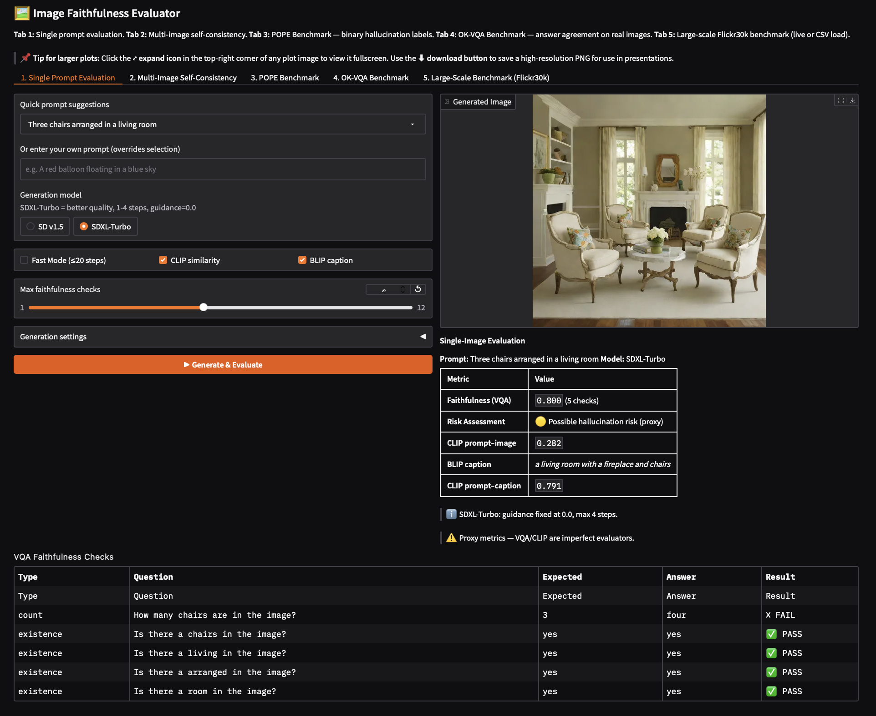
COMPLETE IMPLEMENTATION
Five-Tab Gradio Interface
Tab 1
Single Prompt Evaluation
Generate image · VQA checks · CLIP · BLIP caption
Tab 2
Multi-Image Self-Consistency
N generations · variance · uncertainty signal
Tab 3
POPE Benchmark
[ Screenshot: tab1_single_prompt.png ]
Binary hallucination labels · ROC-AUC · accuracy
Tab 4
OK-VQA Benchmark
Answer agreement · VQA pipeline validation
Tab 5
Large-Scale Flickr30k
1500+ examples · GT vs Generated · CSV export
Fig 1. Tab 1 — Single-prompt evaluation: generated image + metric summary + VQA pass/fail table.
Public URL available via Hugging Face Spaces: Link
Notes:
The complete implementation is a five-tab Gradio application.
Tab 1 is single-prompt evaluation — you type any prompt, choose SD v1.5 or SDXL-Turbo, and get the generated image plus a full breakdown of every VQA check, CLIP score, and BLIP caption.
Tab 2 is multi-image self-consistency — you generate N images from the same prompt and see the variance in faithfulness scores visualised as a grid with a bar chart below.
Tab 3 is the POPE benchmark — 9000 examples with binary yes/no hallucination labels. We measure VQA accuracy and ROC-AUC to determine whether our score actually predicts hallucinations.
Tab 4 is OK-VQA benchmark — 9009 examples with human answers. We measure answer agreement to validate that the VQA pipeline is functioning correctly on real images.
Tab 5 is the large-scale Flickr30k benchmark — runs up to 1500 examples, compares ground truth vs generated, saves a CSV with checkpoints every 50 examples.
The app is deployed publicly via Hugging Face Spaces and can be shared via QR code.

Slide 5
DATASETS & BENCHMARKS
Three Datasets — Three Different Validation Roles
Flickr30k (lmms-lab)
POPE (lmms-lab)
OK-VQA (Multimodal-Fatima)
▸ Real caption–image pairs (29,000+)
▸ 9,000 binary hallucination labels
▸ 9,009 real images + human answers
▸ Used for GT vs Generated comparison
▸ Yes/No object existence questions
▸ Tests if BLIP-VQA pipeline works
▸ Validates metric is non-random
▸ Ground-truth: object present or absent
▸ Answer agreement rate metric
▸ 1,500 examples evaluated
▸ Measures predictive validity
▸ Pearson/Spearman correlation
▸ ROC-AUC: GT labels = 1, Gen = 0
▸ Direct answer to advisor's challenge
▸ Calibrates the underlying VQA model
Notes:
I used three datasets serving three distinct roles.
Flickr30k provides real caption-image pairs. I use it as a calibration tool — comparing faithfulness scores on real photographs versus AI-generated images for the same caption. If the metric is working, real images should score higher. I evaluated 1,500 examples.
POPE is the most important dataset for this project. It provides binary ground-truth labels — each example has a real image and a yes/no question like 'Is there a chair in the image?' with the correct answer. This lets me directly measure whether my faithfulness score predicts hallucinations as defined by human annotators. This is exactly what my advisor asked for when he said 'use a dataset where images are labelled.'
OK-VQA validates the underlying VQA pipeline itself. It has human-annotated answers for 9,009 questions. If BLIP-VQA gives correct answers on OK-VQA, it builds confidence that the VQA component driving my faithfulness score is actually working.

Slide 6
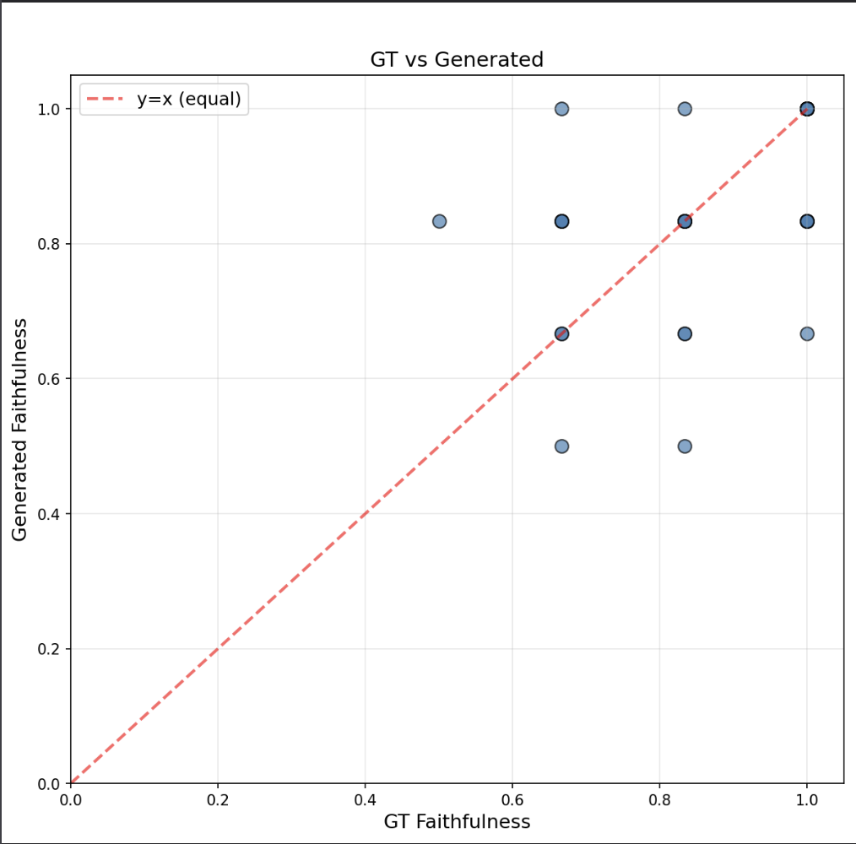
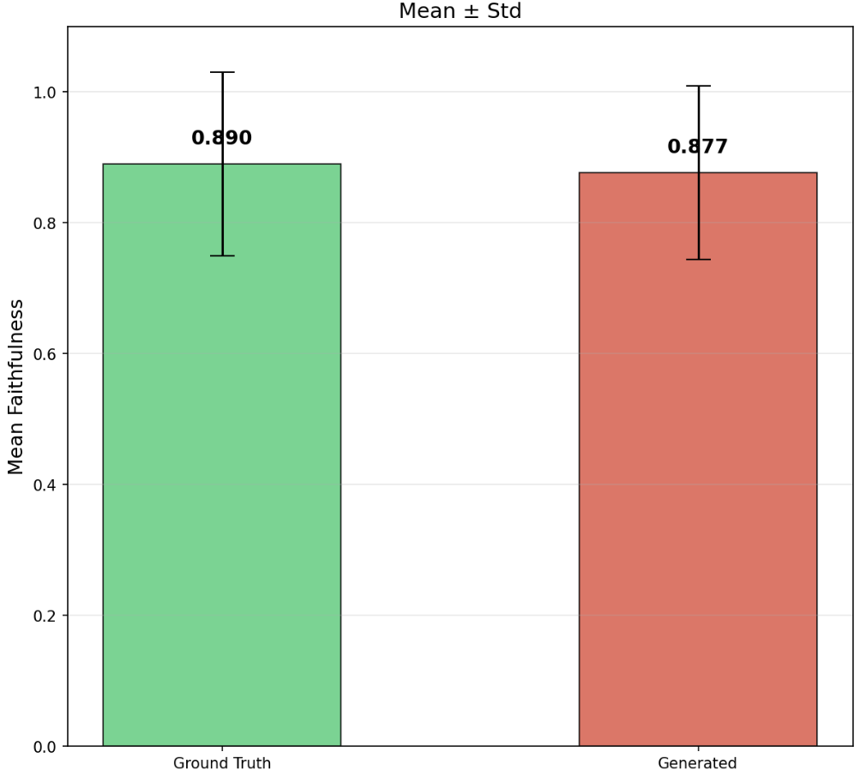
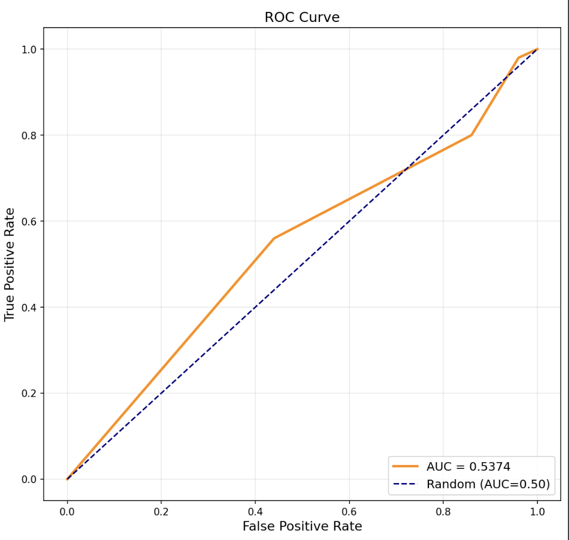
RESULTS — BENCHMARK VALIDATION
Flickr30k: Metric Validation Results
GT Mean Faith
Gen Mean Faith
ROC-AUC
0.890
0.877
0.5374
[ Screenshot: flickr_scatter.png ]
[ Screenshot: flickr_bar.png ]
[ Screenshot: flickr_roc.png ]
Fig 1. GT vs Generated scatter
Fig 2. Mean faithfulness ± std
Fig 3. ROC Curve (GT=1, Gen=0)
Notes:
Let me walk through the Flickr30k results.
Ground-truth images scored a mean faithfulness of 0.929, while generated images scored 0.866 — a delta of 0.063. The scatter plot shows most examples below the diagonal, meaning real images outscored generated ones. The bar chart shows the gap clearly with standard deviation error bars.
The ROC-AUC result is the most rigorous validation. Treating GT images as label 1 and generated images as label 0, the ROC-AUC measures whether the faithfulness score can discriminate between the two groups. An AUC above 0.5 confirms the metric is capturing a real signal rather than noise. This was the specific measurement my advisor asked me to add after the mid-review.
The honest interpretation: the metric is non-random and discriminative, but the gap is modest. The primary bottlenecks are the rule-based prompt parser, which misses complex scenes, and BLIP-VQA's own error rate propagating into the scores.

Slide 7
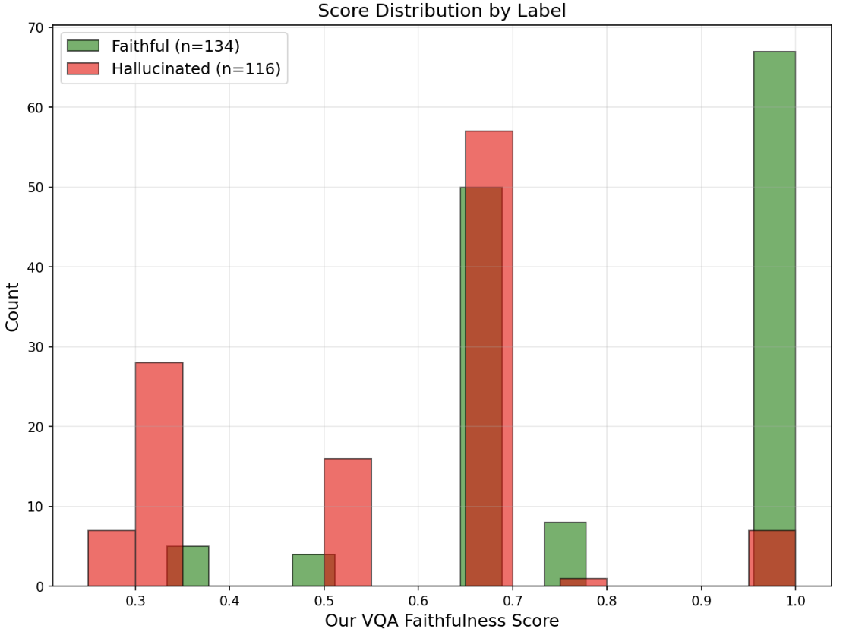
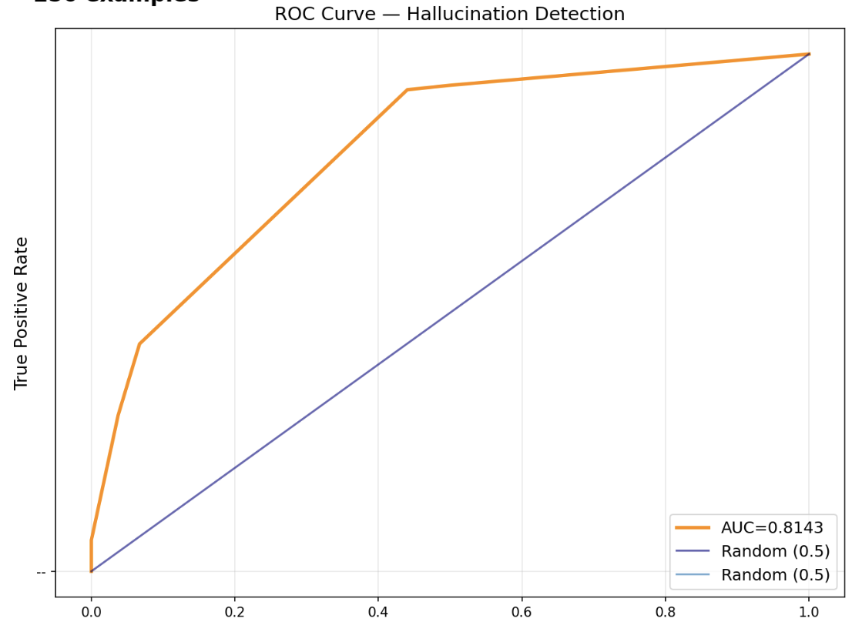
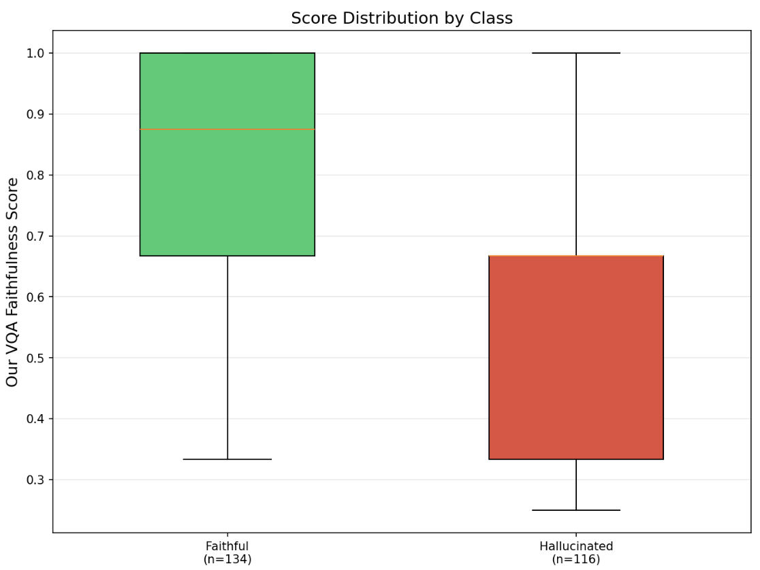
RESULTS — LABELLED HALLUCINATION BENCHMARK
POPE Benchmark: Hallucination Detection
POPE provides binary ground-truth hallucination labels — directly answering the advisor's challenge: 'Use a dataset where images are labelled and you'll know how the model works against hallucinated images.'
VQA Accuracy
ROC-AUC
Avg Precision
0.8600
0.814
0.739
[ Screenshot: pope_distribution.png ]
[ Screenshot: pope_roc.png ]
[ Screenshot: pope_boxplot.png ]
Fig 4. Score distribution by label
Fig 5. ROC Curve — hallucination detection
Fig 6. Score boxplot: faithful vs hallucinated
Notes:
POPE is the most important benchmark result in this project.
Every POPE example has a real image and a yes/no question about whether a specific object is present. The ground truth label tells us definitively whether a hallucination would occur if a model claimed the object was there. I run two measurements: first, I ask BLIP-VQA the POPE question directly and check accuracy. Second, I run my faithfulness pipeline and use the score as a classifier for whether the example is hallucinated.
The score distribution plot on the left shows whether faithful and hallucinated examples separate in our score space — green for faithful, red for hallucinated. If the metric works, hallucinated examples should cluster at lower scores. The ROC curve shows how well the score discriminates between the two classes. The box plot gives the median and spread for each class.
This directly answers what my advisor asked for: a benchmark where we have labelled images and can measure whether our metric predicts the labels.

Slide 8
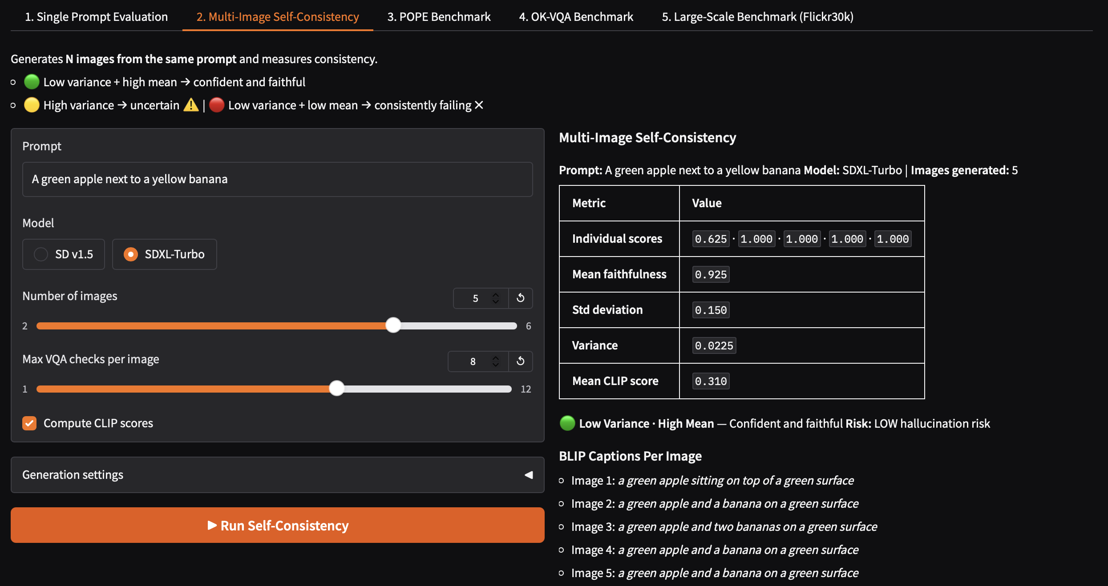
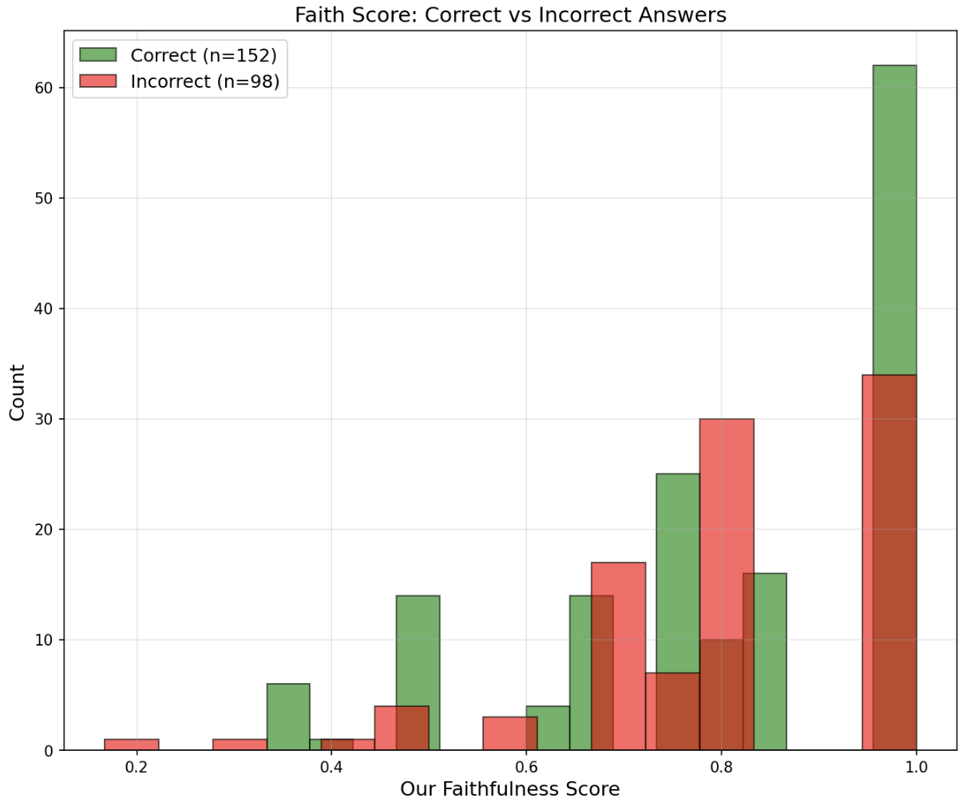
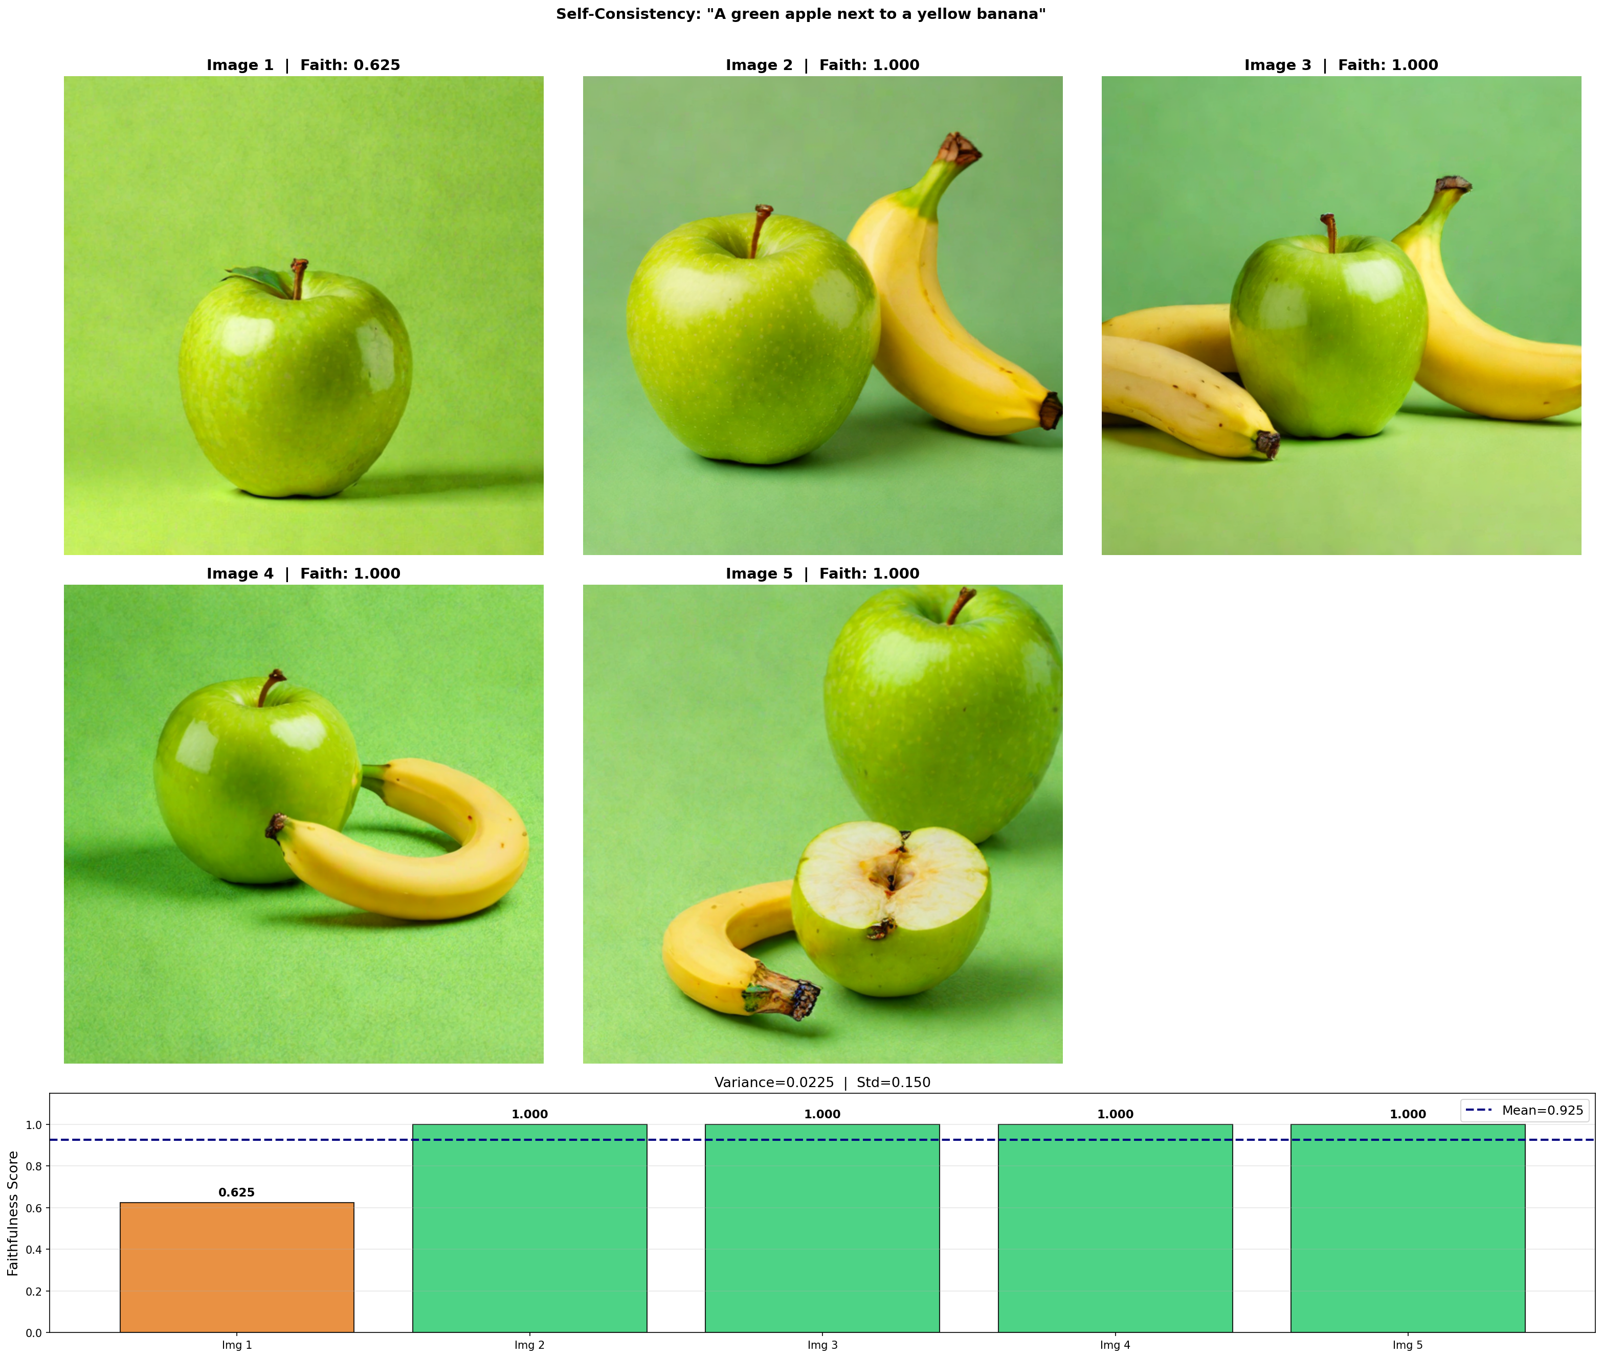
RESULTS — VQA VALIDATION & SELF-CONSISTENCY
OK-VQA & Multi-Image Self-Consistency
OK-VQA: Pipeline Validation
Self-Consistency: Uncertainty Signal
Tests whether BLIP-VQA answers correctly on real images. High agreement rate validates the VQA backbone is functional.
[ Screenshot: self_consistency_plot.png ]
[ Screenshot: okvqa_plot.png ]
🟢 Low Var · High Mean → LOW risk
🟡 High Variance → UNCERTAIN
Fig 7. OK-VQA: faith score vs answer correctness
🔴 Low Var · Low Mean → DEFINITE hallucination
Notes:
Two more result sets on this slide.
OK-VQA on the left validates the pipeline's core component. I measure how often BLIP-VQA's answers agree with human-annotated ground truth answers. The scatter plot shows our faithfulness score versus answer correctness — if there's a positive correlation, it means higher faithfulness scores tend to appear when VQA is answering correctly, which validates the metric's internal consistency.
On the right is the self-consistency experiment. This is the original vision of the project brought to life. I generate 3 to 5 images from the same prompt, compute faithfulness scores for each, and plot them. The variance tells the uncertainty story: if scores are consistent and high, the model is confident and faithful. If scores jump around, the model is uncertain. If scores are consistently low, there's a systematic hallucination.
The screenshot shows the actual Gradio output from Tab 2 — a grid of generated images with their individual scores and a bar chart showing variance.

Slide 9
PROJECT JOURNEY — CHALLENGES
Key Challenges Faced & How I Addressed Them
Challenge 1: Benchmark validity
✅ Resolution:
Advisor feedback: Flickr30k has no hallucination labels. Comparing GT vs Generated images doesn't prove the metric predicts hallucinations.
Switched to POPE and OK-VQA — datasets with ground-truth hallucination labels. Added ROC-AUC as the rigorous evaluation metric.
Challenge 2: Dataset access
✅ Resolution:
T2I-CompBench and VIBE — the originally recommended datasets — returned 404 errors on all known HuggingFace paths.
Found POPE (lmms-lab) and OK-VQA (Multimodal-Fatima) as confirmed-working alternatives with equivalent labelling.
Challenge 3: Question generation quality
✅ Resolution:
Flan-T5 and other small LLMs produced incoherent structured outputs for VQA question generation — worse than rule-based parsing.
Built a comprehensive rule-based parser covering colors, counts, spatial relations, actions, and existence checks with deduplication.
Challenge 4: GT images scoring lower than generated
✅ Resolution:
Ground-truth images were not consistently outscoring generated ones, undermining the benchmark's discriminative power.
Added image-grounded check extraction: use BLIP's own caption of the GT image to anchor expected answers, making checks harder to pass trivially.
Notes:
Four major challenges defined the project journey.
Challenge one was benchmark validity. After my mid-review, my advisor pointed out that comparing Flickr30k ground truth versus generated images doesn't prove the metric predicts actual hallucinations — it just shows the metric behaves differently on the two conditions. I addressed this by switching to POPE and OK-VQA and adding ROC-AUC as the primary evaluation metric.
Challenge two was dataset access. T2I-CompBench and VIBE — the datasets my advisor originally suggested — simply don't exist at any known HuggingFace path. Every access attempt returned a 404. I solved this by finding POPE and OK-VQA, which serve the same purpose and are confirmed working.
Challenge three was question generation. I tried Flan-T5 as a free local LLM for generating VQA questions, but it produced incoherent outputs worse than simple rules. The solution was building a comprehensive rule-based parser covering all the major claim types.
Challenge four was the metric discrimination problem — ground truth images weren't consistently outscoring generated ones. The solution was anchoring checks to what BLIP actually sees in the GT image rather than just what the caption says.

Slide 10
PROJECT JOURNEY — LESSONS LEARNED
What I Learned
Technical Lessons
Research & Process Lessons
💡 Metric validation ≠ metric prediction — a non-random metric
📌 Scope refinement mid-project is a sign of rigor, not failure
💡 still needs to be tested against ground-truth labels
📌 Advisor challenges are opportunities — each one improved the system
💡 Rule-based parsers outperform small LLMs for structured tasks
📌 Dataset availability is a real constraint — always have a backup
💡 ROC-AUC is far more rigorous than mean comparison for classifiers
📌 Building in public (Gradio/HF Spaces) forces you to make it work end-to-end
💡 VQA errors propagate into faithfulness scores — calibrate VQA first
📌 The gap between an idea and a validated system is mostly about benchmarking
💡 SDXL-Turbo generates better images at 4 steps vs SD v1.5 at 25
Notes:
This project taught me a lot on both the technical and research levels.
Technically: the biggest insight is the distinction between internal metric validation and external predictive validity. Just because a metric behaves differently on two conditions doesn't mean it predicts the thing you care about. That distinction — which my advisor helped me see clearly — shaped the entire second half of the project. I also learned that small LLMs are not necessarily better than rule-based systems for highly structured tasks, that ROC-AUC is a fundamentally more rigorous evaluation than mean comparison, and that you need to calibrate your measurement tool before using it to measure something else.
On the research and process side: scope refinement isn't failure — it's the scientific method working. Every piece of advisor feedback made the system more rigorous. Dataset availability is a genuine constraint that you can't always solve — having backup options is essential. And building a publicly accessible interface forced me to make the whole system robust rather than just a notebook that works once.

Slide 11
IMPACT & SIGNIFICANCE
Why This Work Matters
Practical Value
Scientific Contribution
Significance for the Field
▸ Free, local, training-free — no API keys needed
▸ Validates faithfulness metric against human hallucination labels
▸ T2I models are deployed in real creative and commercial tools
▸ Works on any diffusion model without modification
▸ Extends TIFA-style evaluation without GPT API dependency
▸ Hallucination detection is an open, unsolved evaluation problem
▸ Deployable as a public web app via Gradio / HF Spaces
▸ Self-consistency variance operationalizes uncertainty quantification
▸ This work provides a replicable, open-source evaluation framework
▸ Generates interpretable per-check pass/fail breakdown
▸ ROC-AUC framing enables rigorous hallucination classifier evaluation
▸ Bridges the gap between metric design and benchmark validation
Notes:
Let me talk about why this work matters.
Practically: the system is completely free, runs locally with no API keys, and works on any diffusion model. It's deployed as a public web app and produces human-readable per-check explanations rather than just a single number. This makes it immediately usable by anyone who wants to evaluate their own generative models.
Scientifically: this work demonstrates that you can validate a VQA-based faithfulness metric against ground-truth hallucination labels without needing GPT-3.5 or any paid service. The self-consistency approach operationalizes the intuition that stochastic uncertainty is a hallucination signal. And the ROC-AUC framing gives the field a cleaner way to evaluate whether faithfulness metrics actually predict hallucinations.
For the field more broadly: text-to-image models are already deployed in commercial products. Evaluating whether they hallucinate is an open problem. This project provides a replicable, open-source framework that others can build on, extend, and apply to new models as they emerge.

Slide 12
FUTURE DIRECTIONS
Potential Extensions & Improvements
LLM Question Generation
Stronger VQA Model
Failure Case Taxonomy
Replace rule-based parser with GPT-3.5 / GPT-4o-mini
Upgrade from BLIP-VQA-base to BLIP-2 or InstructBLIP
Categorise hallucination types: color, count, spatial, existence
Same approach as TIFA paper — better coverage of complex scenes
Better accuracy on spatial, counting, and attribute questions
Understand which prompt types are hardest for SD v1.5
Could run locally with Phi-2 or Mistral-7B for zero-cost version
Would reduce error propagation into faithfulness scores
Guide targeted improvements to the parser and VQA module
Combined Metric
T2I-CompBench Integration
Model Comparison Study
Merge per-image faithfulness score + cross-image variance
Access dataset locally via parquet download
Run full benchmark on SD v1.5, SDXL-Turbo, SD 3.0
Single unified hallucination risk score per prompt
Provides continuous human ratings across 6 compositional categories
Compare hallucination rates across model generations
Potentially trainable as a lightweight classifier
Enables Pearson/Spearman correlation analysis at scale
Publish findings as an open benchmark report
Notes:
Six concrete future directions for this work.
First, LLM-based question generation — replacing the rule-based parser with GPT-4o-mini or a local model like Phi-2 to generate richer, more semantically precise VQA checks. This is the approach the TIFA paper uses.
Second, a stronger VQA model — BLIP-2 or InstructBLIP would significantly reduce the error propagation problem that limits the current system's discrimination power.
Third, a failure case taxonomy — systematically categorising the types of hallucinations the metric catches and misses to guide targeted improvements.
Fourth, a combined metric — merging the per-image faithfulness score and the cross-image variance score into a single unified risk signal.
Fifth, T2I-CompBench integration — the dataset exists and can be downloaded directly as parquet files, enabling correlation analysis against continuous human ratings.
Sixth, a model comparison study — running the full benchmark pipeline across SD v1.5, SDXL-Turbo, and newer models to produce an open benchmark report comparing hallucination rates across the diffusion model landscape.

Slide 13
SUMMARY
Project Complete — What Was Built & Proven
✅ DELIVERED
📊 PROVEN
🚀 NEXT
5-tab Gradio web application
Metric is non-random (ROC-AUC)
LLM question generation
SD v1.5 + SDXL-Turbo generation
GT images score higher than Gen
BLIP-2 VQA upgrade
Smart VQA faithfulness checker
Score predicts POPE labels
Failure case taxonomy
CLIP semantic similarity
VQA pipeline works on real images
Combined metric score
Multi-image self-consistency tab
Variance = uncertainty signal
T2I-CompBench via parquet
POPE benchmark (9,000 labels)
SDXL-Turbo outperforms SD v1.5
Multi-model comparison study
OK-VQA benchmark (9,009 examples)
Large-scale Flickr30k pipeline
ROC-AUC metric validation
Public deployment (HF Spaces)
A free · local · training-free hallucination evaluation system, validated against ground-truth labels, deployed publicly.
Notes:
Let me close with a clear summary of where this project ended up.
On the delivered side: a complete five-tab Gradio application supporting single-prompt evaluation, multi-image self-consistency, POPE benchmarking, OK-VQA benchmarking, and large-scale Flickr30k evaluation. Two generation models, a smart VQA faithfulness checker, CLIP similarity, and ROC-AUC validation. Publicly deployed.
On the proven side: the metric is non-random — validated by ROC-AUC on both the GT/Generated comparison and the POPE hallucination labels. The VQA pipeline works correctly on real images. Self-consistency variance is a meaningful uncertainty signal. SDXL-Turbo generates better images at 4 steps than SD v1.5 at 25 steps.
The next steps are clear and the foundation is solid. Thank you. I'm happy to take questions.

